Slide 1
ISM 6225 Distributed Information Systems Instructor: Daniel Clinton Spring 2023
Final Project Presentation
Group 4:
Prasanna Kumar Tummala
Parimal Singh
Lakshmi Tulasi Thummu
Swetha Veerla

Slide 2
Agenda:
Website briefing
Flask introduction
Application Design
Folder hierarchy
Demo
Website walkthrough
Conclusion

Slide 3
CMS is a university website that talks about the courses offered in the college.
Visitors can get an idea of the courses offered in the college, track progress of college ranking and have an idea of number of enrollments every year alongst with the recruitment statistics.

Slide 4
Design
To develop and bring our project to life, we utilized several markup and programming languages, including:
HTML
CSS
JavaScript
Python Flask

Slide 5

What is Flask?
Flask is a framework developed in Python language.
It can be leveraged to render pages and route various URL’s.
Helps us to achieve modular programming.
Promotes code reusability thereby increasing scalability.

Slide 6
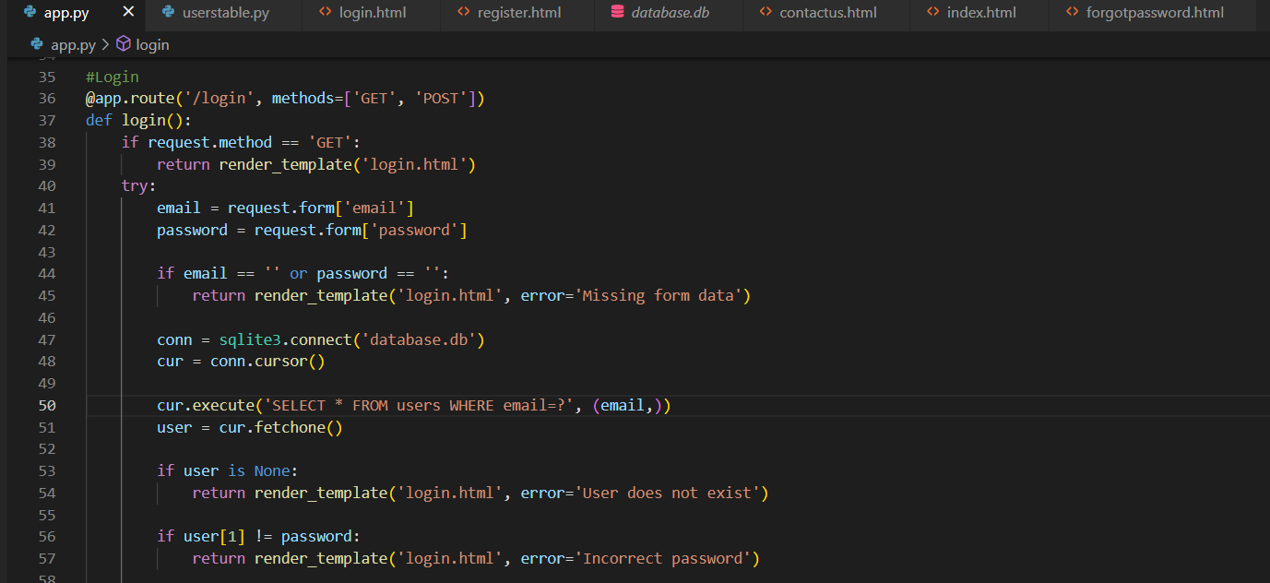
Application Setup
One Route for each webpage.
@app.route('/signin')
def signin():
return render_template('signin.html')

Slide 7
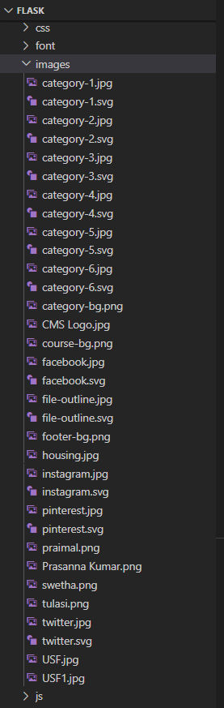
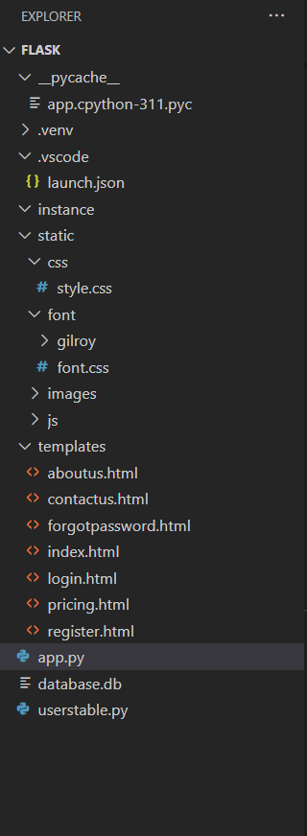
Application Setup
We have added all the
images and Java Script files
into Flask’s Static folder.
Flask Folder Structure

Slide 8
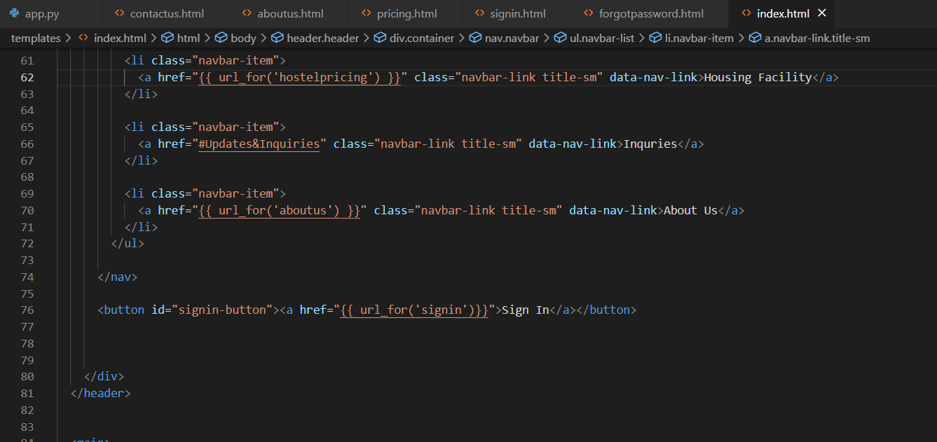
Application Setup
Here, Flask’s url_for() help function is used to generate links to matching routes.

Slide 9
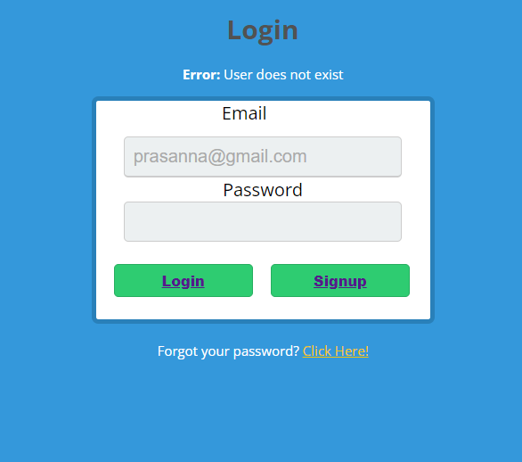
Application Demo
The login form provides secure access to the University website, which contains information about the available courses, Inquires and other information
The login frm will prevent the users who’s information is not in our university database and throughs error “User does not exist”

Slide 10
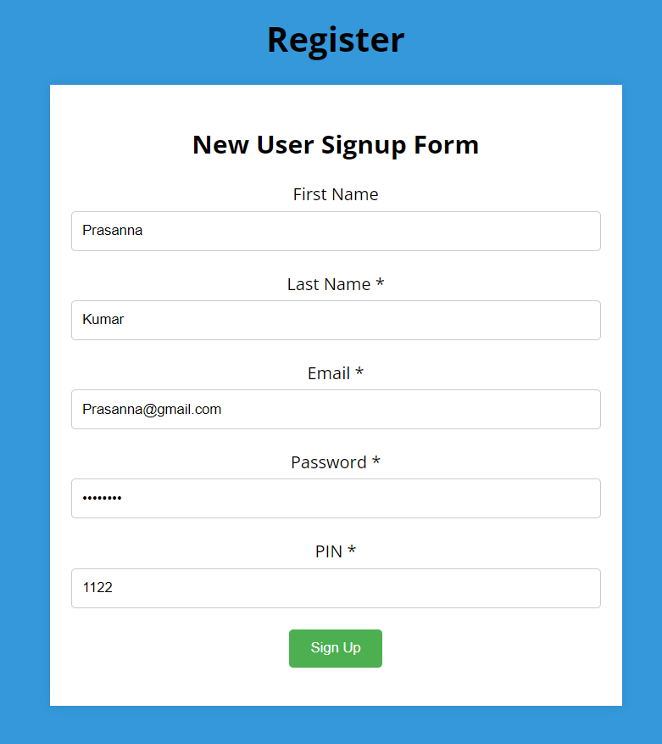
Application Demo
Signing up on the university website is a straightforward process that allows you to access a range of our online services.
It prevents users who are signing up with email of existing user.

Slide 11
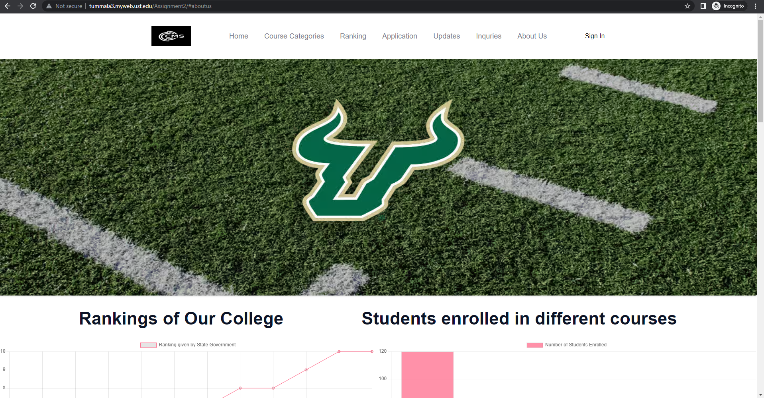
Application Demo
We worked on improvising the responsiveness and compatibility across all devices.

Slide 12
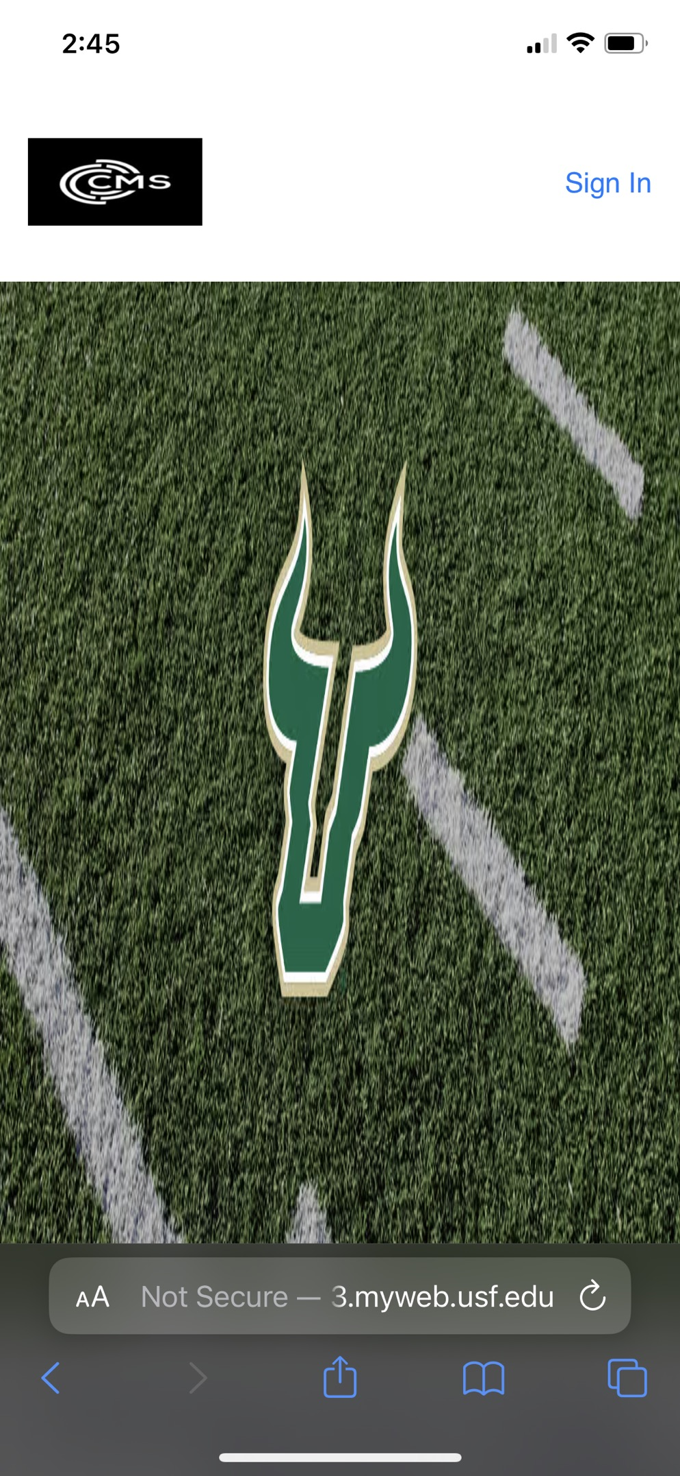
Application Demo
Website compatibility across various devices.
This is the webpage from mobile phone view

Slide 13
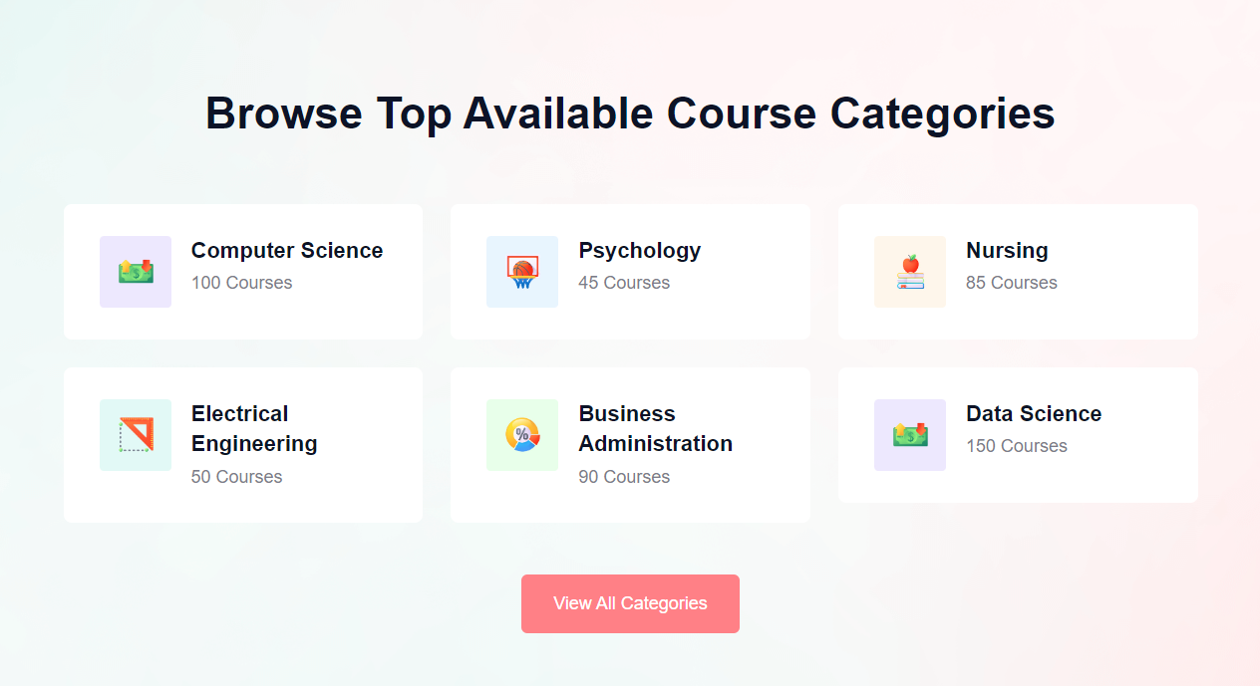
Application Demo

Slide 14
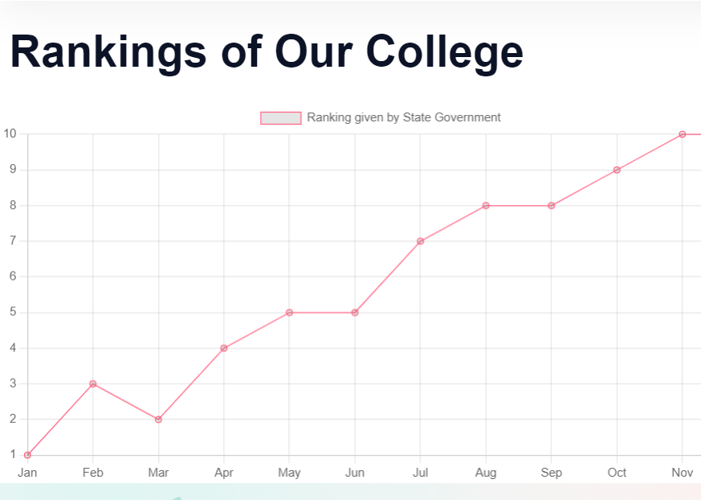
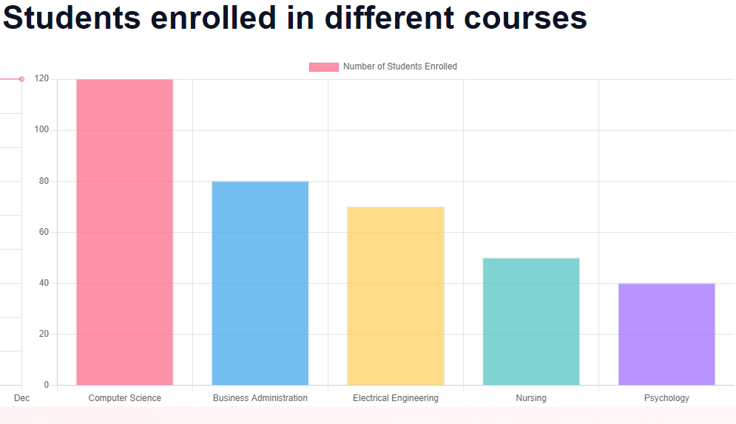
Application Demo – Charts
Overall progress of the institution was shown by designing a line graph that spoke about the improvised rankings with each passing year.
Number of students enrolled across various departments.

Slide 15
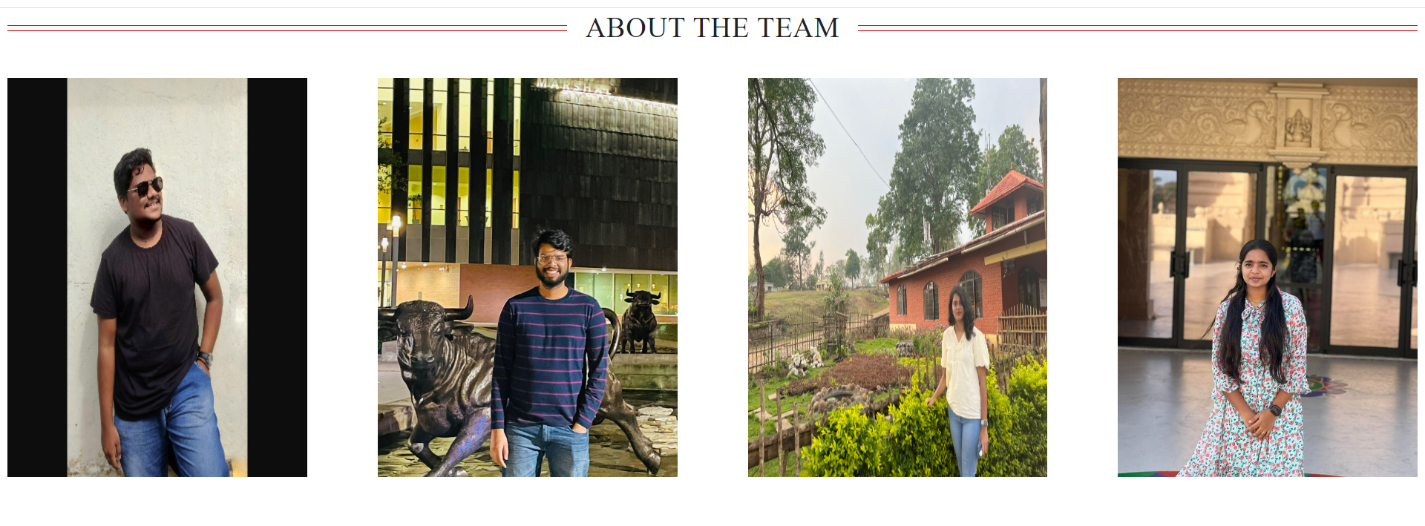
Demo: About Us page
About us page is easily accessible which helps us understand about each team member and their involvement towards achieving this website.
Details can be accessed by hovering over the images.

Slide 16
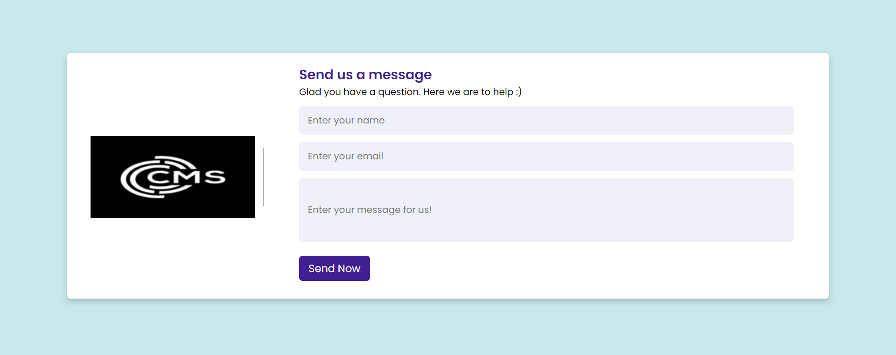
Application Demo
Contact US: Guest can send message if they have any question regarding the university or housing facility.

Slide 17
Learnings:
Don’t wait for the last hour ☺.
Have an image of desired outcome in your head.
Look , feel and compatibility of the website is the key.
Keep it simple and clean(No fancy and useless clutter).
Try to achieve the desired result with the least amount of possible code.
Easy navigation is encouraged.

Slide 18
THANK YOU

